Slide 1
INC 491: Mini Project
Life Expectancy
(WHO) Analysis
Nontawit Markjan 59070504003

Slide 2
What factors affect to life expectancy and how strong are they?

Slide 3

- Global Health Observatory (GHO), WHO gateway to health-related statistics repository
- There are some missing data from less known countries such as Vanuatu, Tonga, Togo, etc.
- Consists of the factors from year 2000 to 2015.
- This dataset is the final version consists of 22 columns and 2,938 rows.

Slide 4
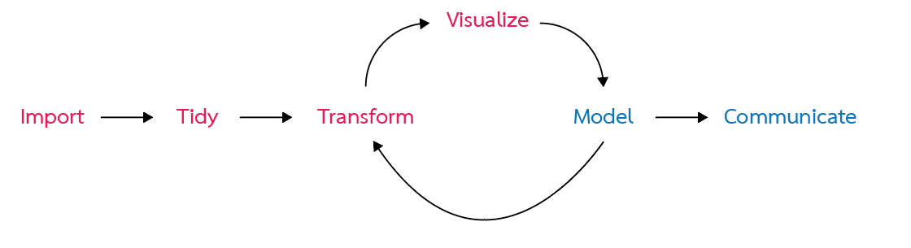

Slide 5
Import
- dataset
- libraries

Slide 6
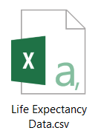
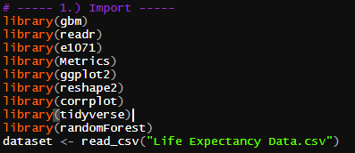
Import

Slide 7
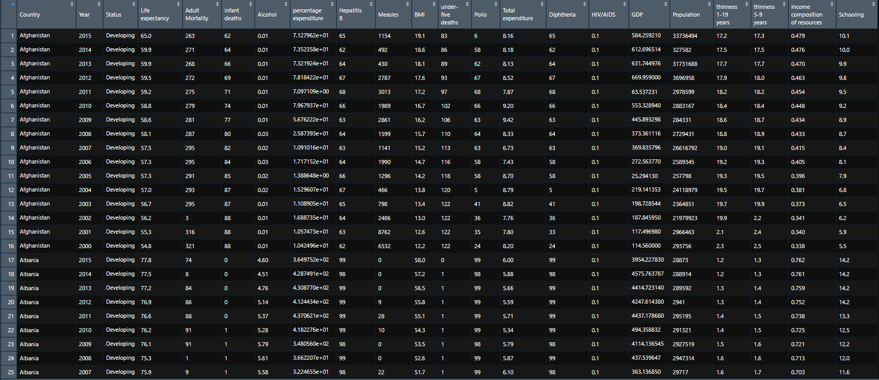
Import

Slide 8
Tidy
- Duplicate original dataset
- Remove null values

Slide 9
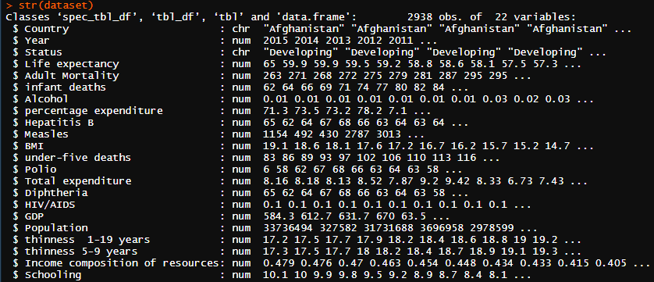
Tidy

Slide 10



Tidy
about a half of dataset
have null value!
Replace null value with
mean in each column

Slide 11
- Rename attributes
Transform
- Convert data type
- Create new column
- Create new data frame,
extract from original dataset

Slide 12
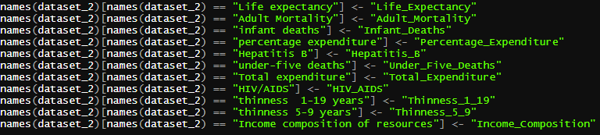

Transform
Rename
the attribute with the space
to prevent error
Convert data type
and separate dataset into
developing countries
and developed countries

Slide 13
- Percentage of country status
Visualize
- Developing VS Developed Countries
- Effect of some factors to life expectancy
- Correlation

Slide 14
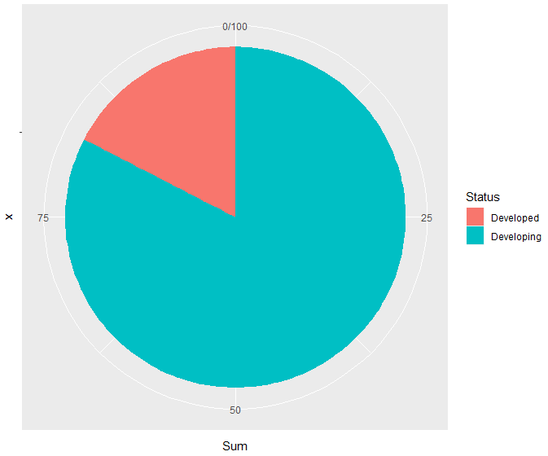

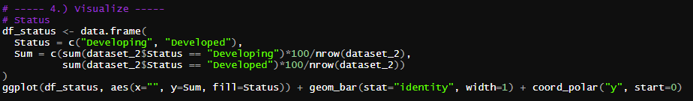
Visualize – % of country status

Slide 15
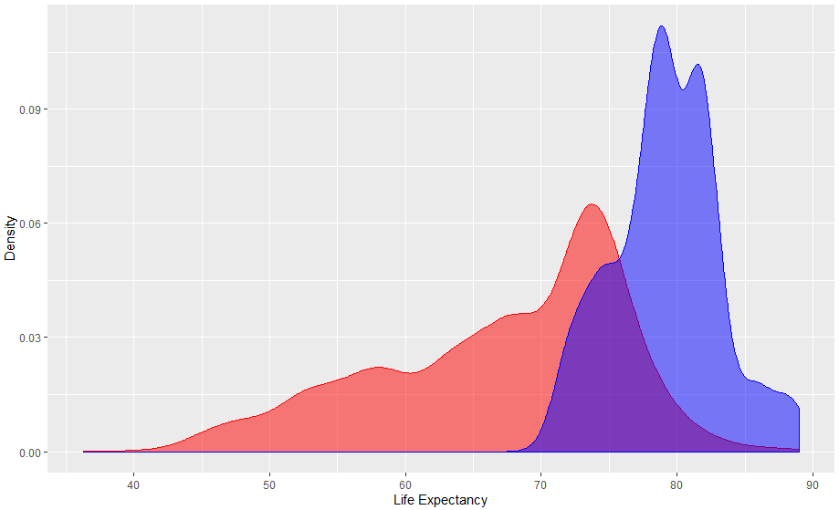
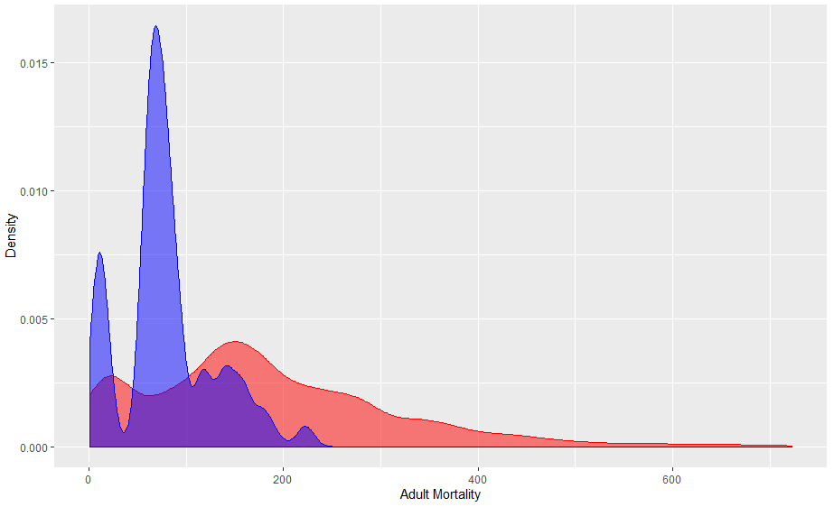
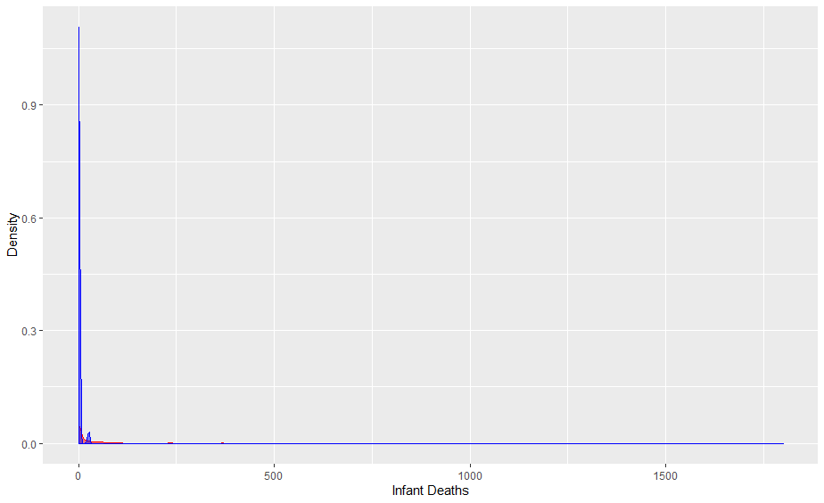
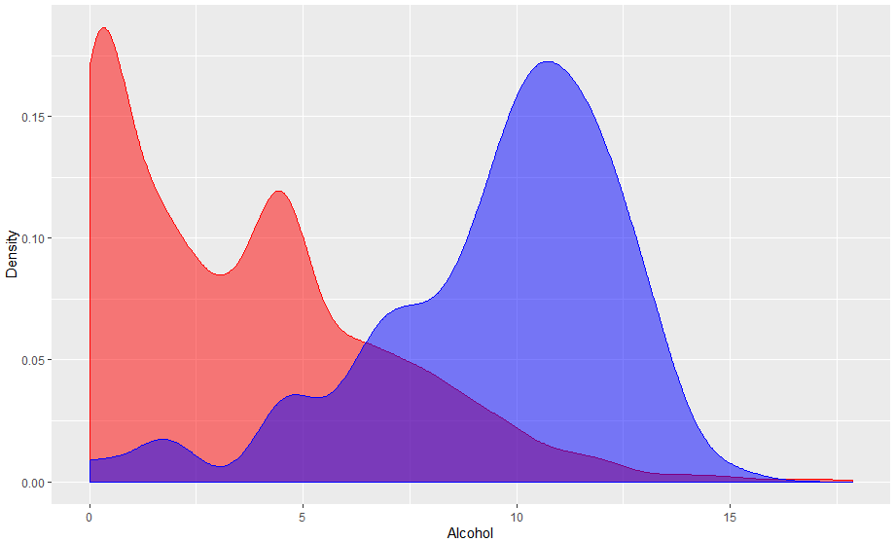
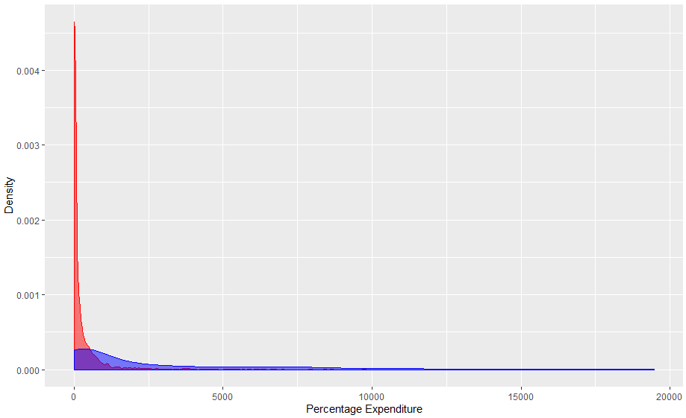
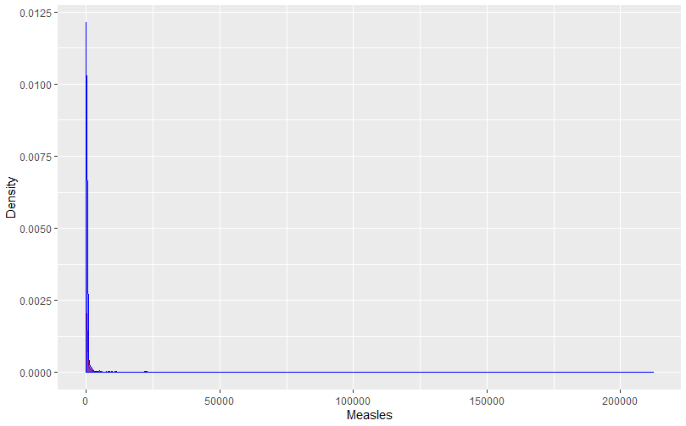
Visualize – Developing VS Developed Countries
Life Expectancy
Adult Mortality
Infant Deaths
Alcohol (per capita, litre)
Percentage expenditure
Measles (cases/1000)

Slide 16
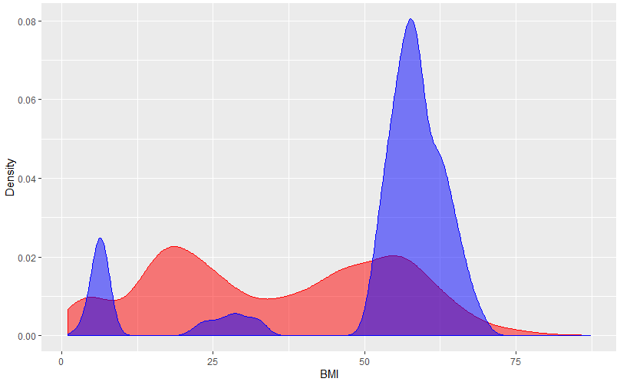
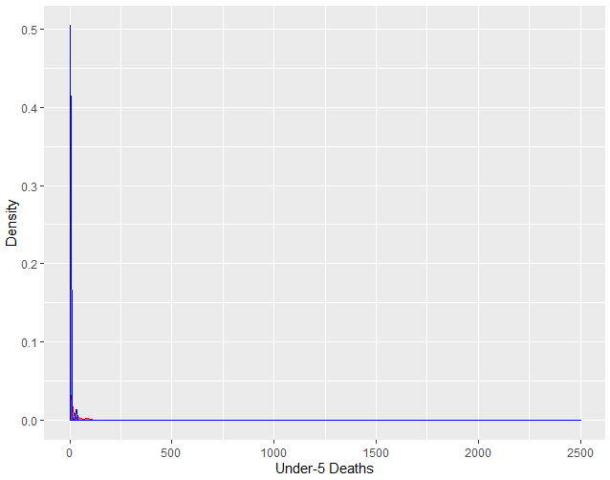
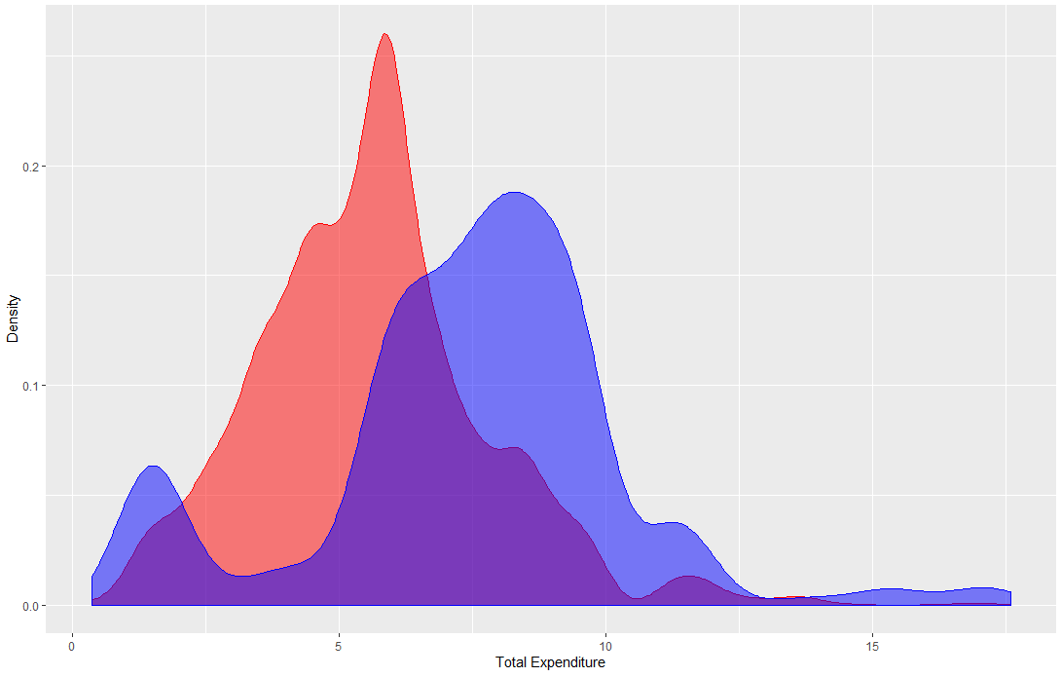
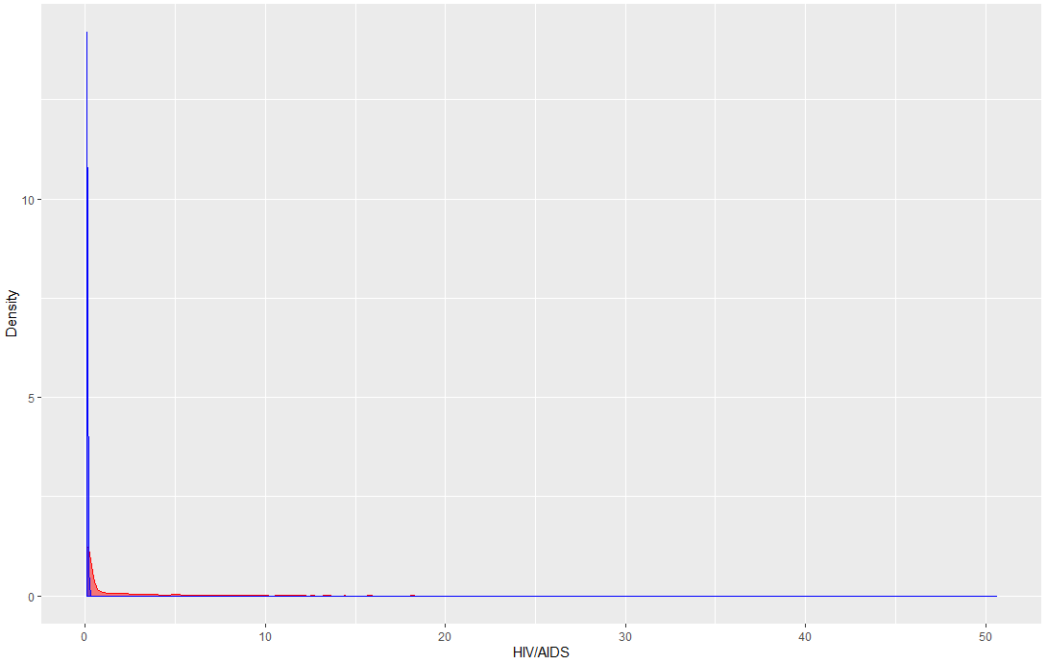
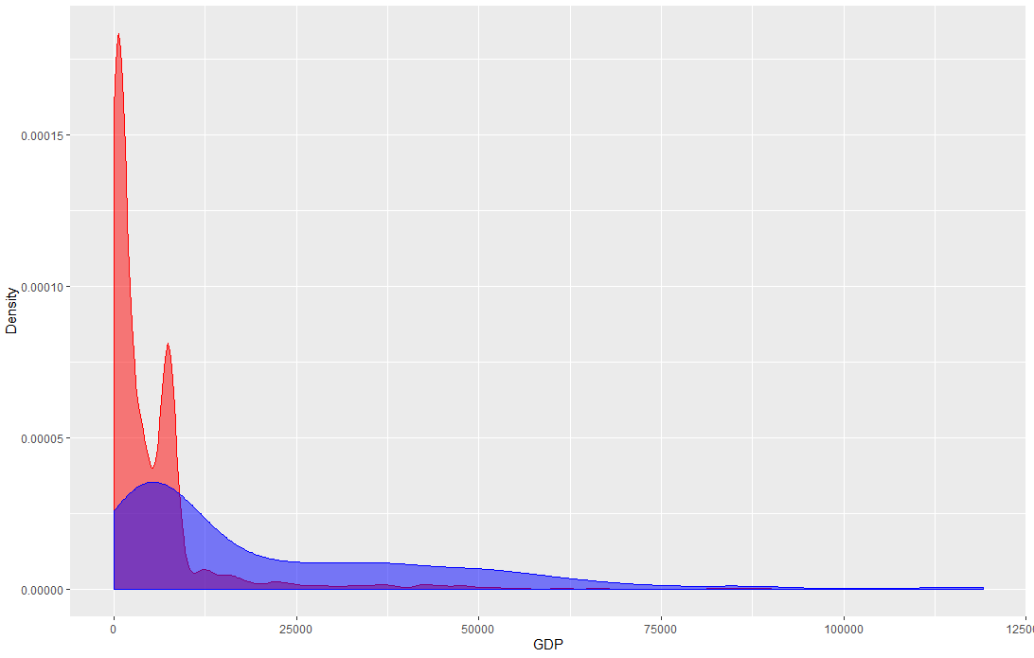
Visualize – Developing VS Developed Countries
BMI
Under-5 deaths
Total expenditure
HIV/AIDS
GDP

Slide 17
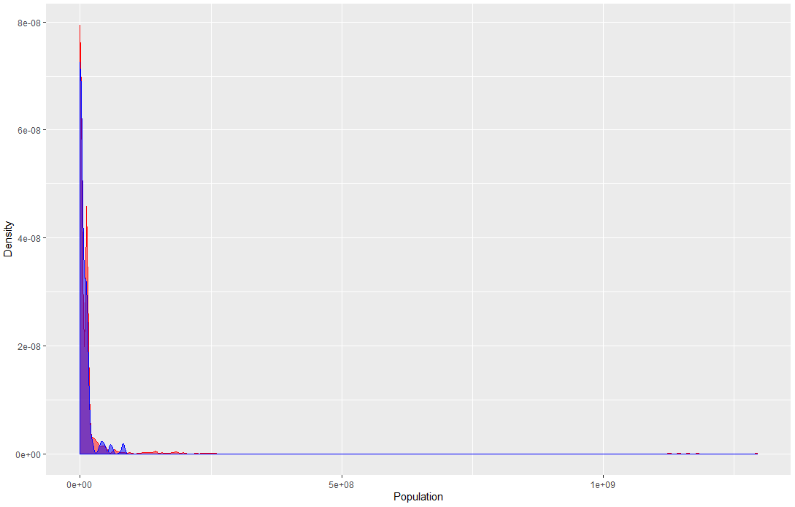
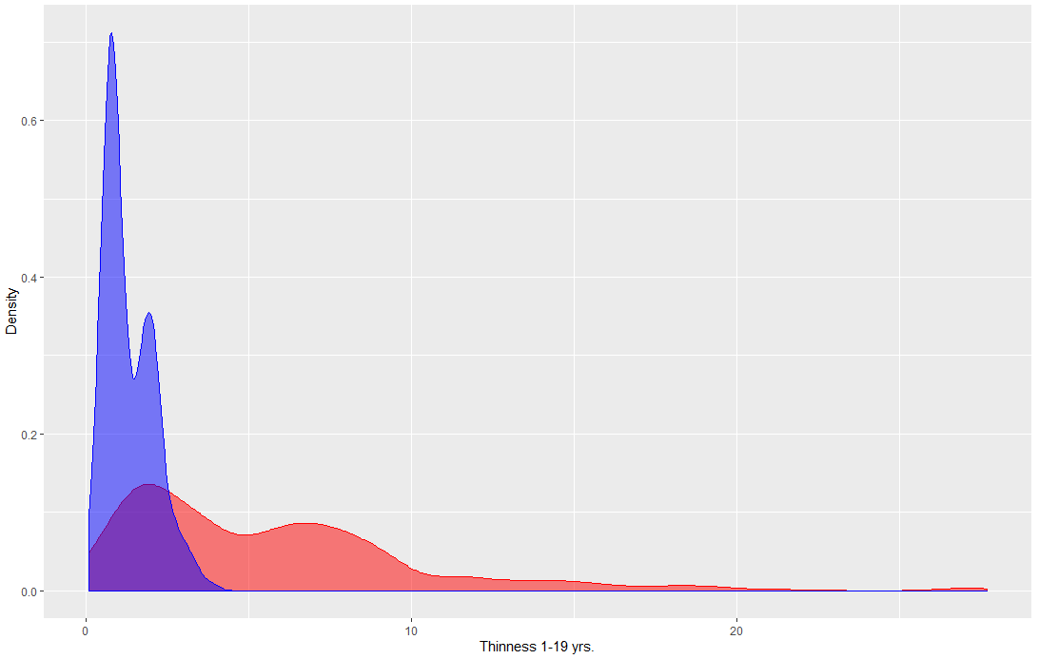
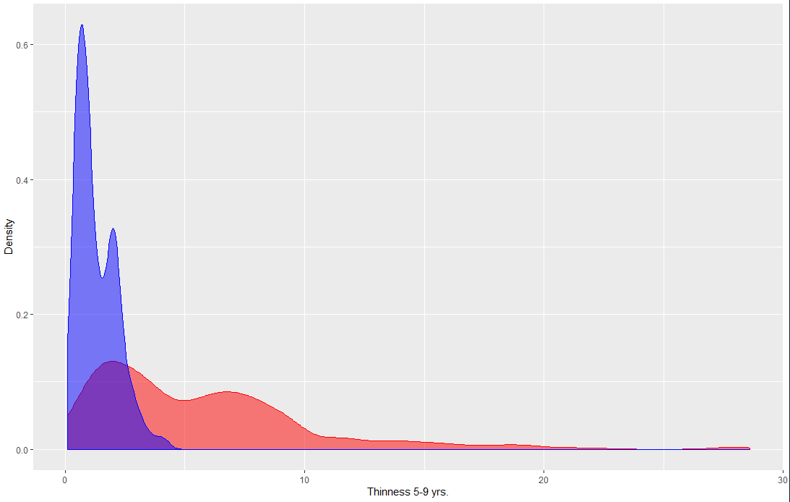
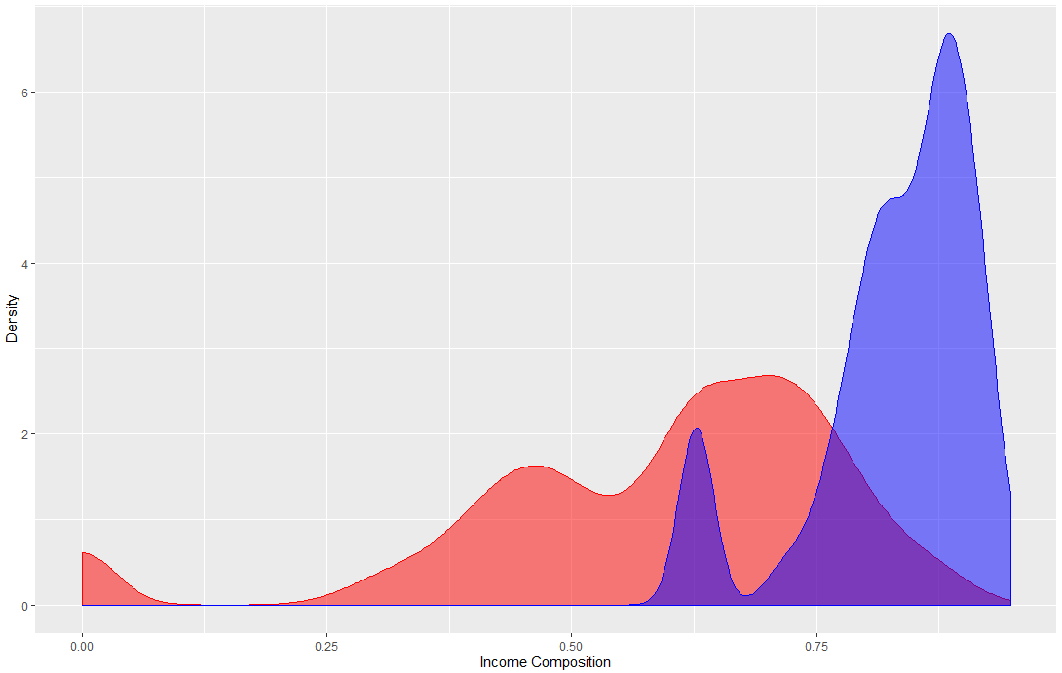
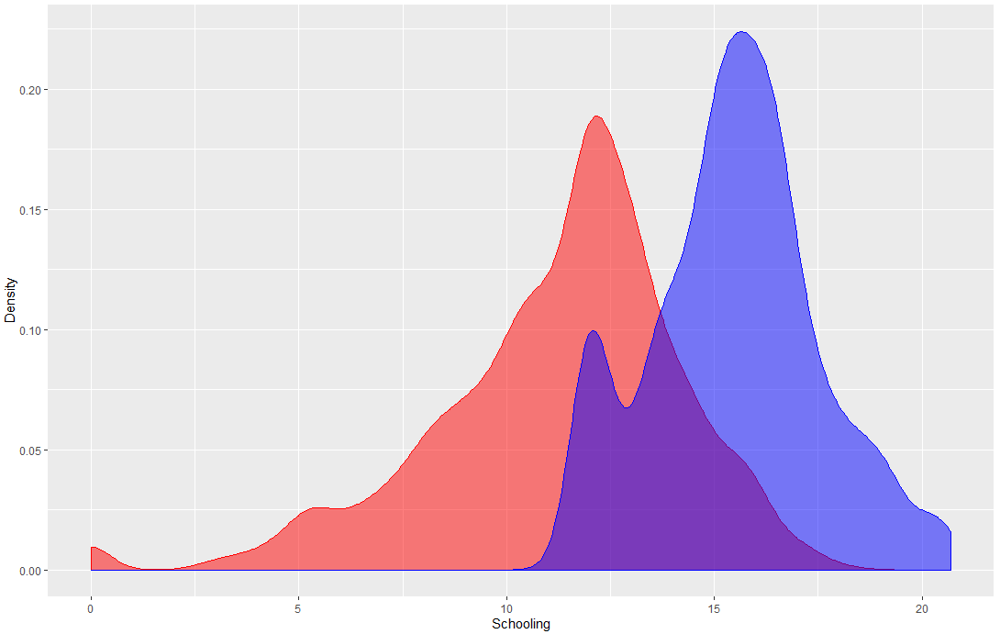
Visualize – Developing VS Developed Countries
Population
Thinness 10-19 years
Thinness 5-9 years
Income composition of resources
Schooling

Slide 18
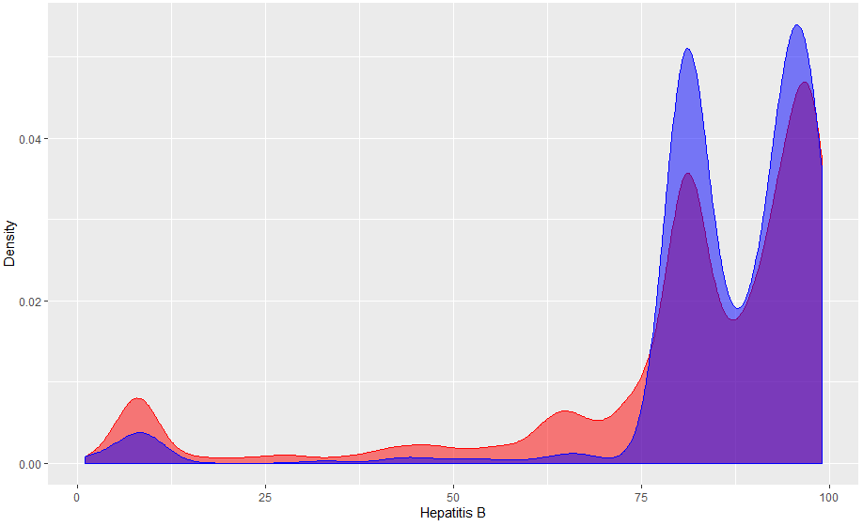
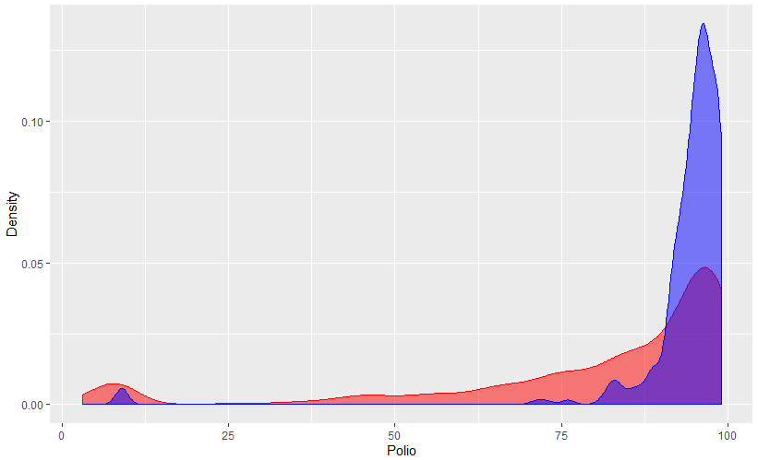
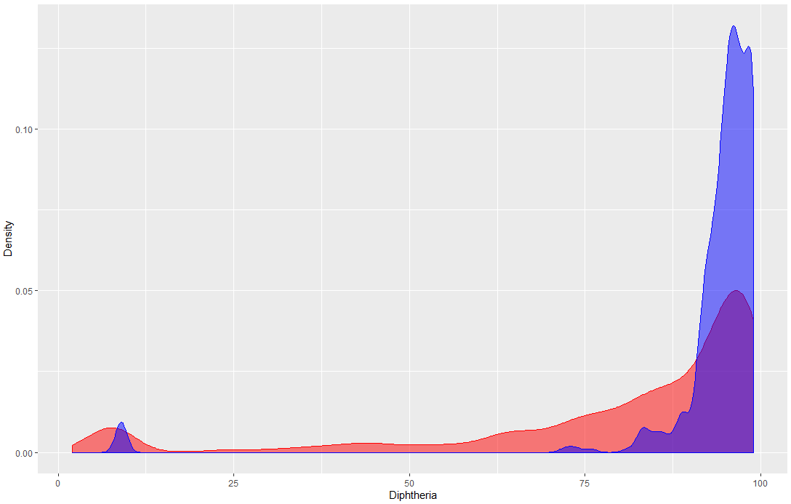
Visualize – Developing VS Developed Countries
Hepatitis B
Polio
Diphtheria

Slide 19
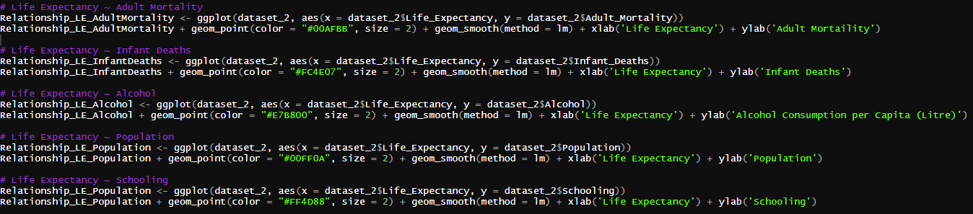
Visualize – Effect of some factors to life expectancy
shows the relationship between some factors to life expectancy, consists of
adult mortality, infant deaths, alcohol, population, and schooling.

Slide 20
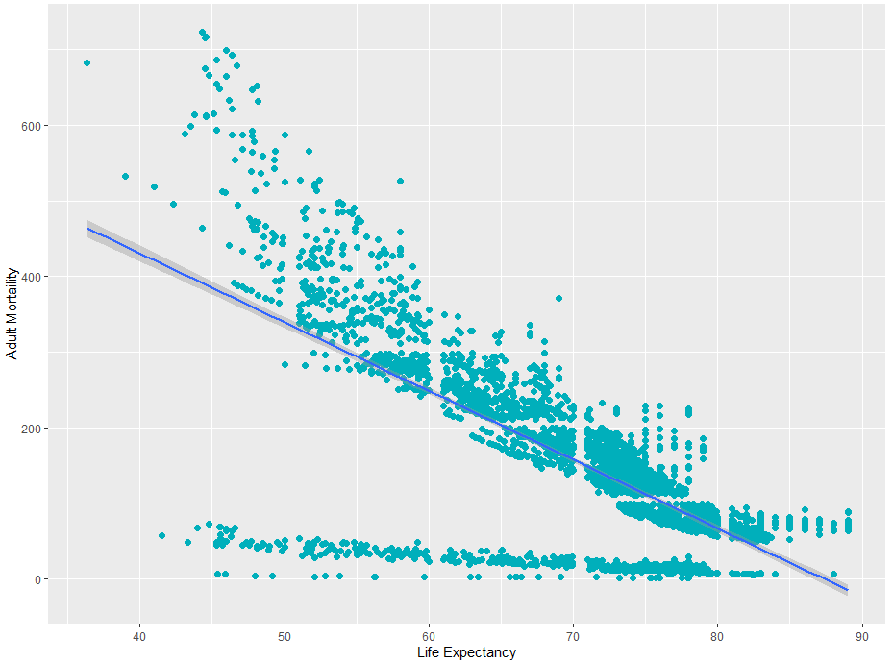
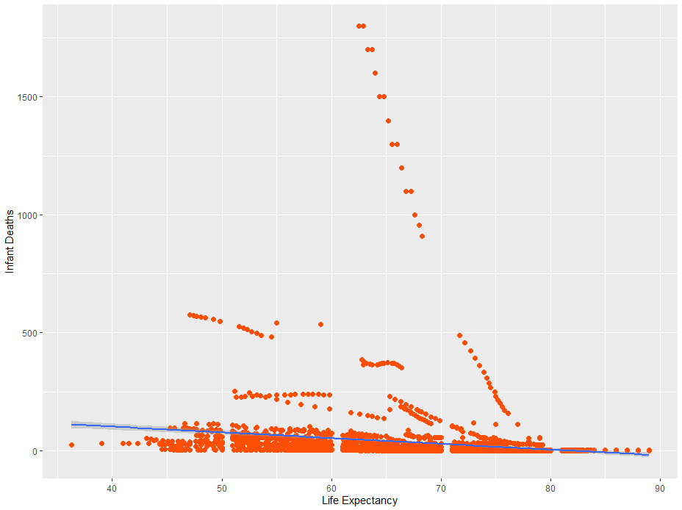
Visualize – Effect of some factors to life expectancy
Adult Mortality
Infant Deaths

Slide 21
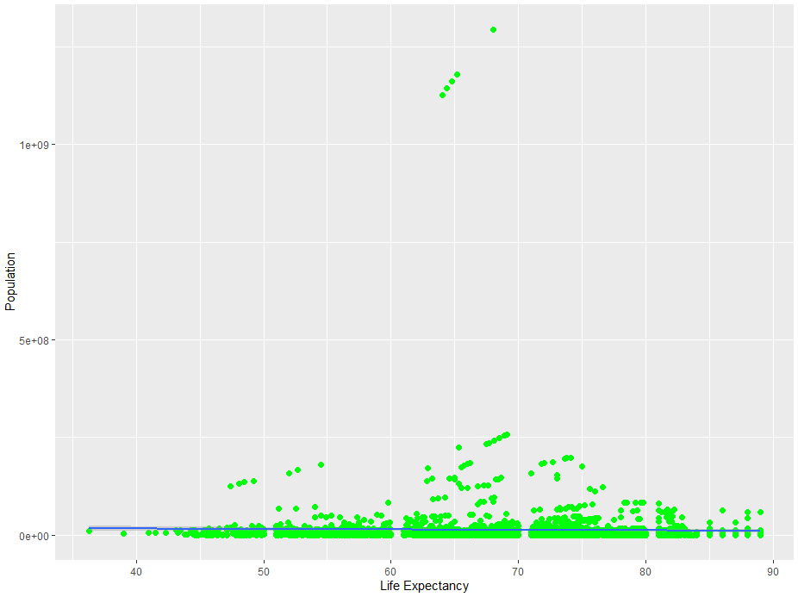
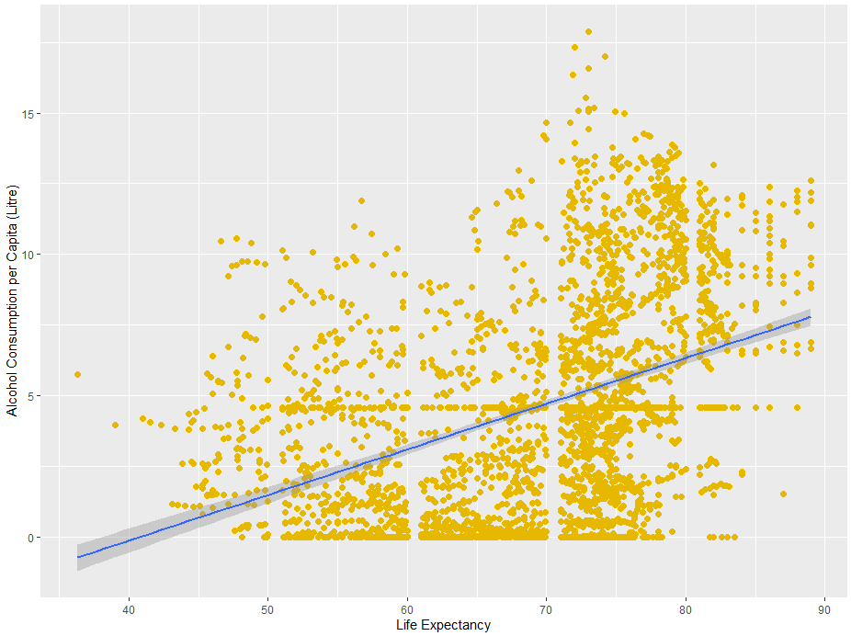
Visualize – Effect of some factors to life expectancy
Population
Alcohol

Slide 22
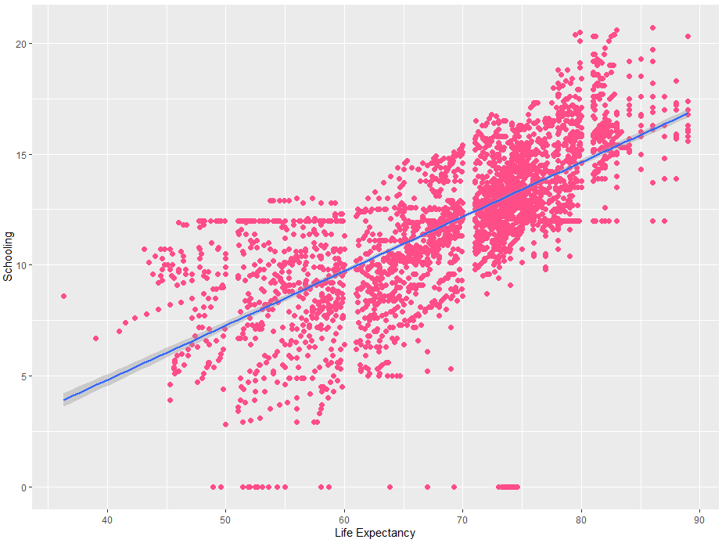
Visualize – Effect of some factors to life expectancy
Schooling

Slide 23
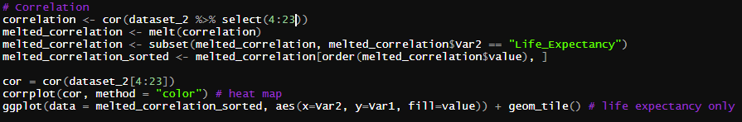
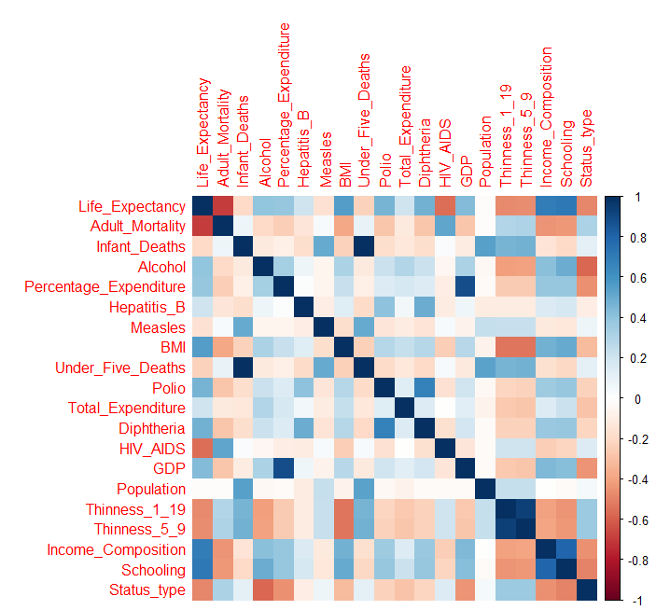
Visualize – Correlation

Slide 24
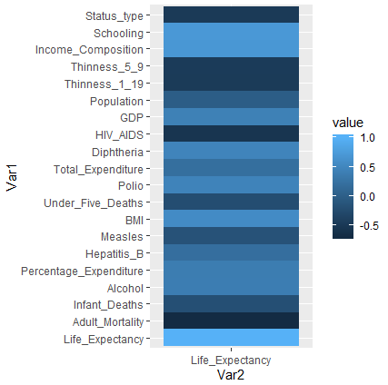
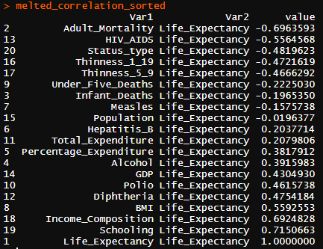
Visualize – Correlation

Slide 25
- Create train and test dataset
Modelling
- Multiple linear regression
- Random forest
- Gradient boosting
- Supported vector machine (SVM)

Slide 26
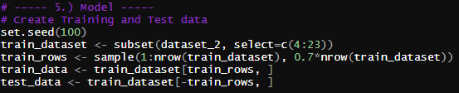
Modelling – Train/Test
70%
30%
Train
Test

Slide 27


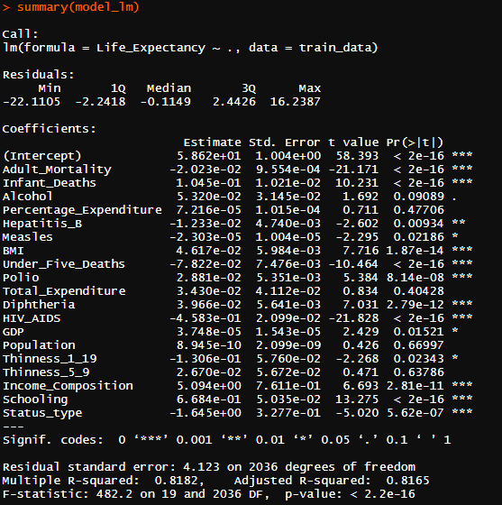
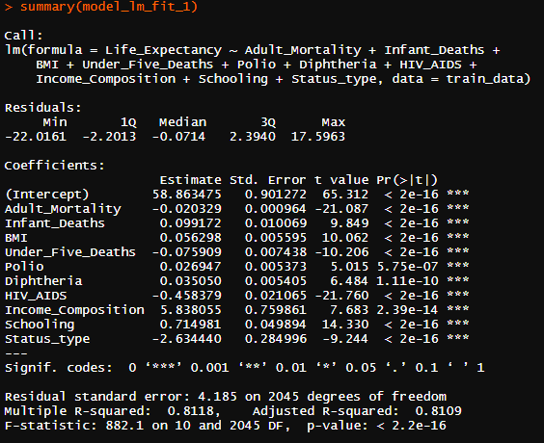
Modelling – Multiple Linear Regression
Normal
With only high significance features

Slide 28

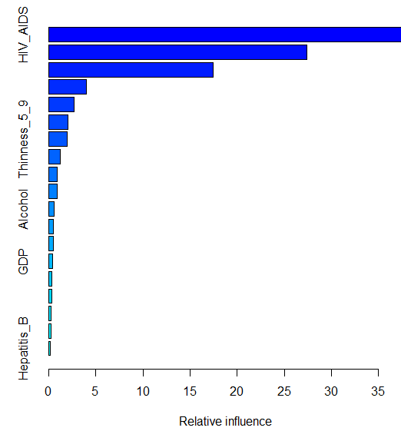

Modelling – Random forest & Gradient Boosting
Random Forest
Gradient Boosting

Slide 29

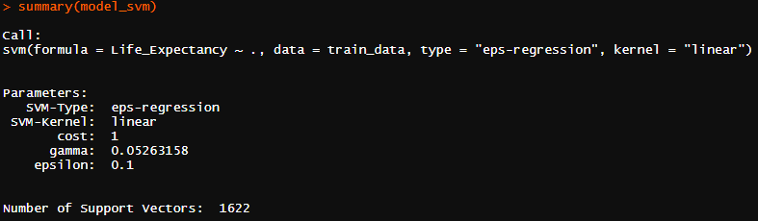
Modelling – Supported vector machine (SVM)

Slide 30
Accuracy
- Mean-squared error (MSE)
- Root-mean-squared error (RMSE)
- Min/max accuracy

Slide 31
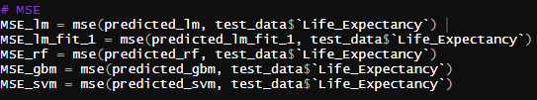

Modelling – Mean-squared error (MSE)

Slide 32
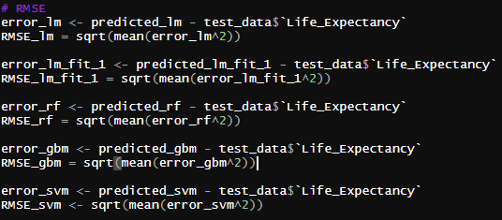

Modelling – Root-mean-squared error (MSE)

Slide 33

Modelling – Min/max accuracy

Slide 34
Summary

Slide 35
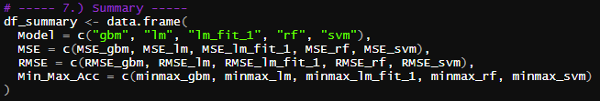
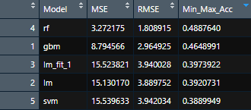
Summary
Model with the highest accuracy is random forest
Top 3 direct proportional
Top 3 inverse proportional
1. Schooling
1. Adult mortality
2. Income/composition of resources
2. HIV/AIDS
3. BMI
3. Status

Slide 36
Thank You!

